Slide 1
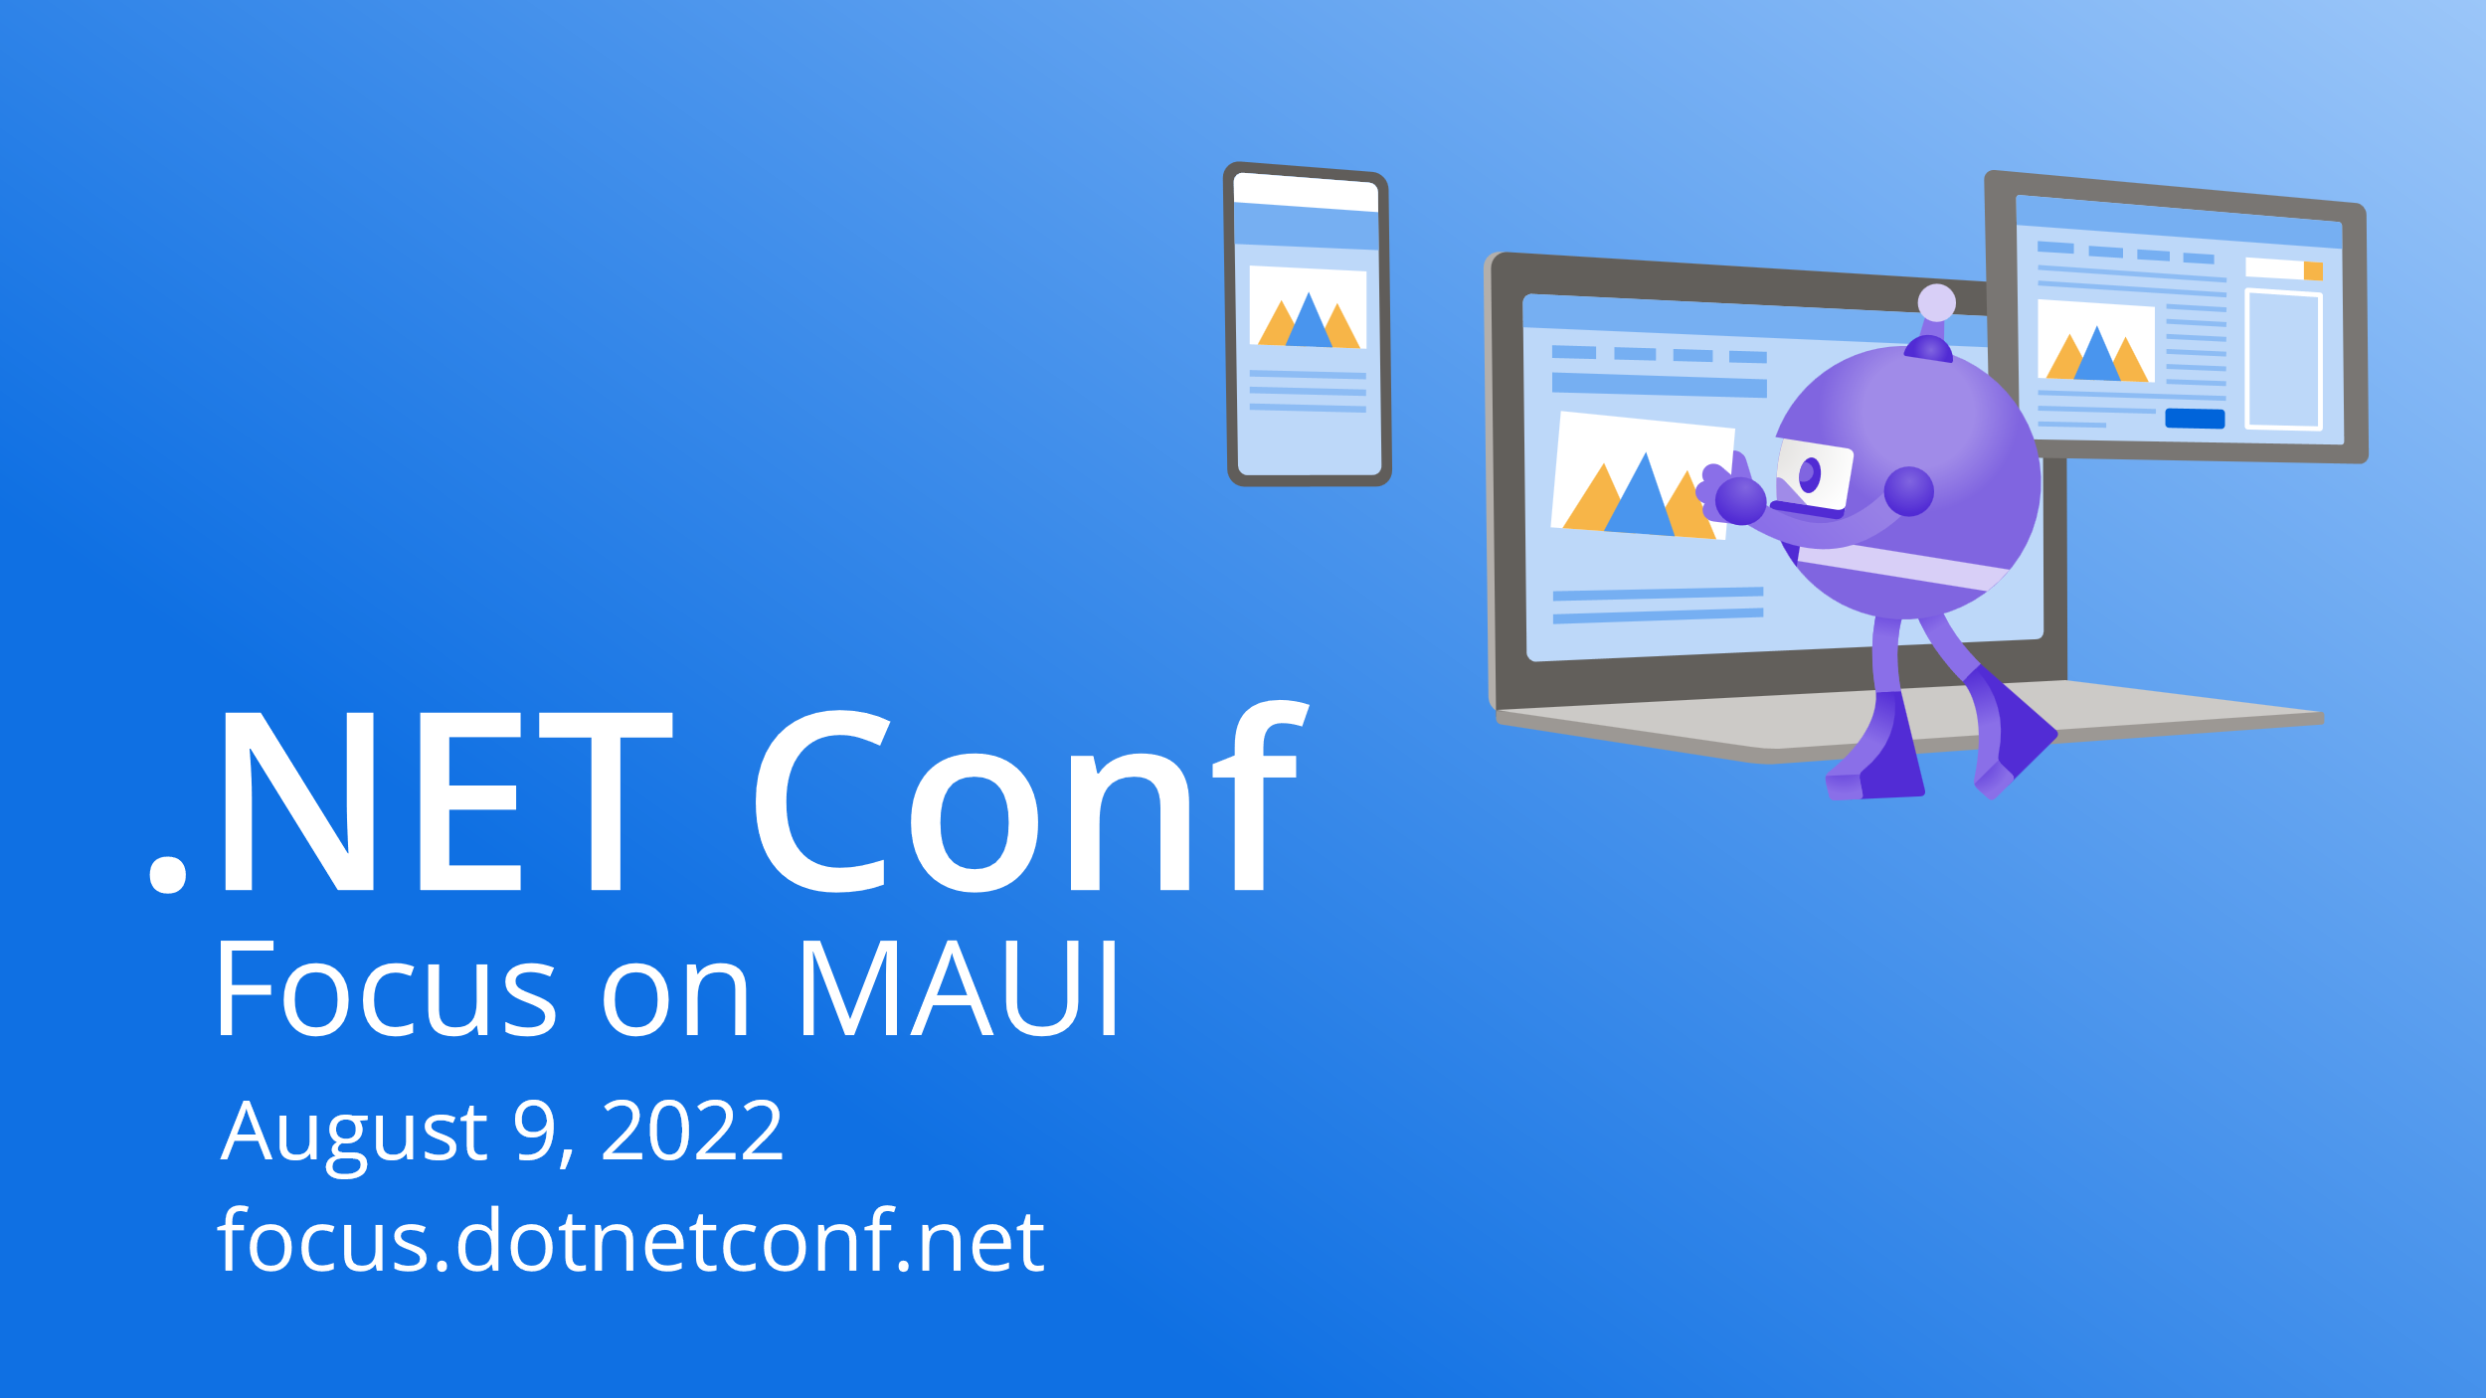

Slide 2

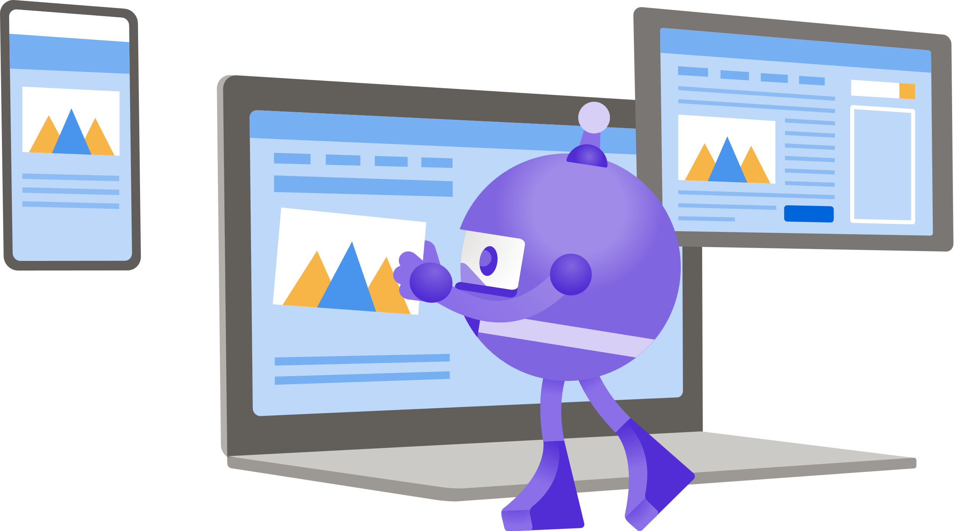
Unit Testing for Our MAUI Applications
Allan Ritchie

Slide 3
Some Areas We Can Test
User Interface
Services
View Models (MVVM)

Slide 4
Demo

Slide 5

Thanks for joining!
Ask your questions live on Twitter #dotNETConf

